Slide 1
Explore, we can learn more. 探索，我們學習更多
We are at Cun Don
我們在村東，
天氣晴

Slide 2
We can see many plants.

Slide 3
We can record many pretty things.

Slide 4
We are proud of our school.

Slide 5
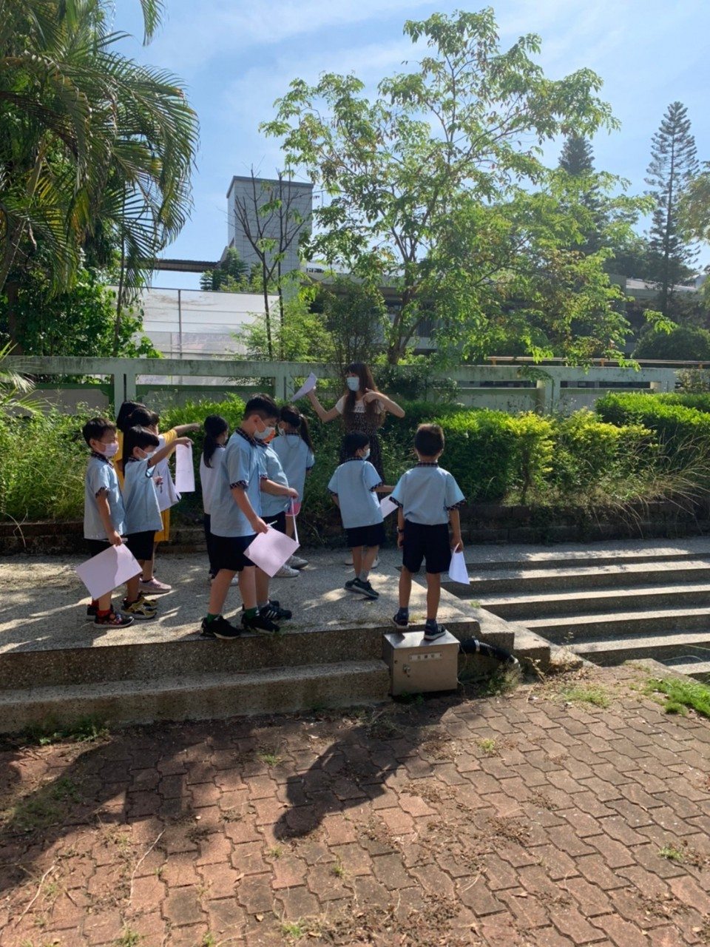
We like our school. 我們喜歡我們的學校。

Slide 6
We like to learn. 我們喜歡學習。

Slide 7
There is much love in our school.

